Slide 1
Java Servlets 03
Spring Valley Tech Corp ∙ Java SMP+ Teacher Training ∙ Jorge Cosgayon

Slide 2
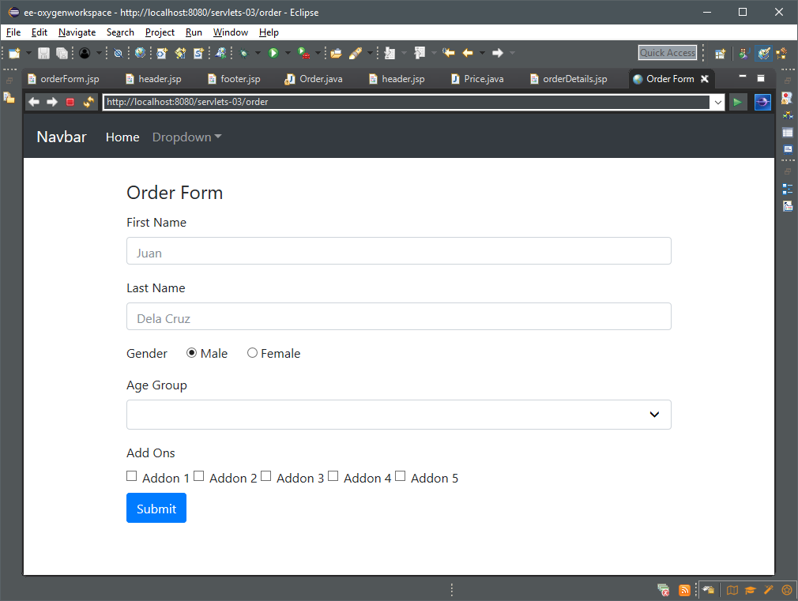
An order form
Project parameters:
An order form with multiple form elements
Separate files for better organization
Incorporate Bootstrap 4.0b
Project reference:
servlets-03
Activity type:
Demonstration

Slide 3
Objectives
Create a servlet that will handle GET and POST requests and execute the business logic of calculating the total price, less discounts
Create and access a static class that will contain the price list
Incorporate basic styling using Bootstrap 4.0b

Slide 4
Outcomes
Learner knows how to separate JSP files into chunks that can be stored separately
Learner knows how to import custom Java classes
Learner knows how to include static CSS and JS files
Learner understands how POST data is handled by the servlet

Slide 5
Instructions
Base price starts at 200
Women get a 20% discount, while men must pay an additional 10%
Customers aged 12 and below, and 56 and up get an additional 20% discount
Customers aged 13-17 get an additional 10% discount
Customers 18-25 get an additional 5% discount
Addon prices:
Addon 1 – 250
Addon 2 – 150
Addon 3 – 2,250
Addon 4 – 750
Addon 5 – 225

Slide 6
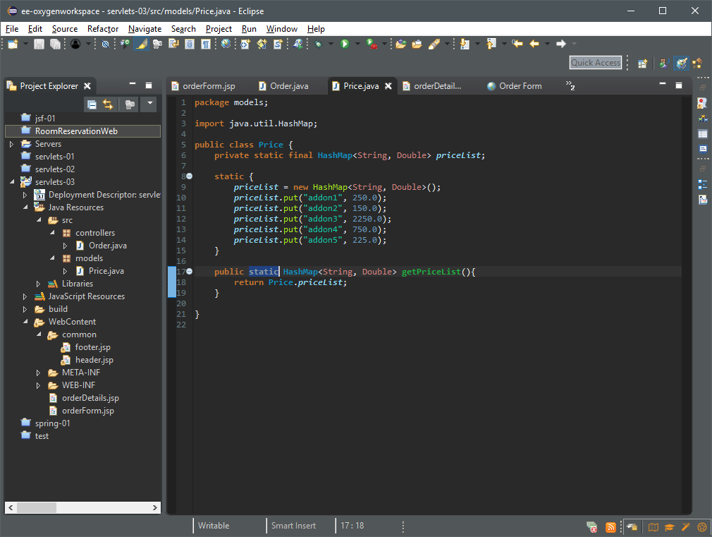
Create the Java classes Order and Price
Create common HTML components (header and footer) in the “common” directory
Create the orderForm and orderDetails JSP files to display input and output

Slide 7
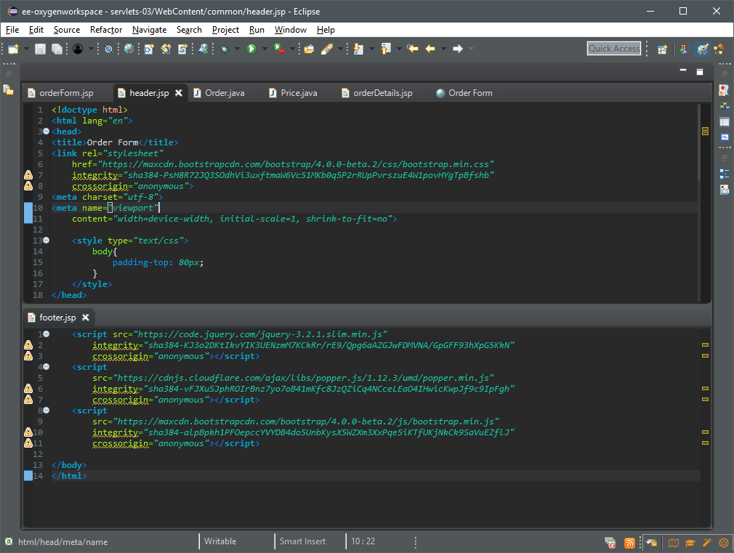
Split the common components of an HTML page:
header.jsp will contain the opening html tag,the head + CSS, and the opeing body tag
footer.jsp will contain links to the JS libraries and the closing tags

Slide 8
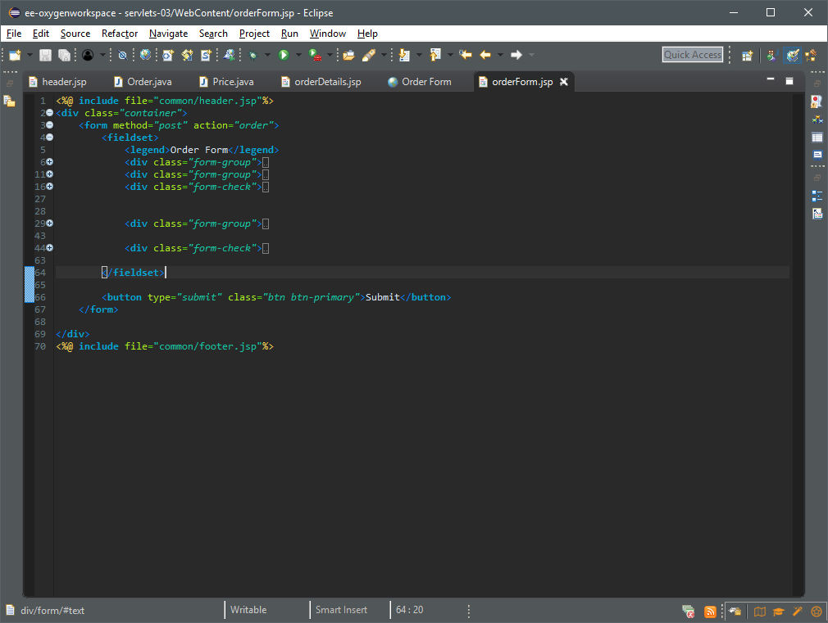
These files will be called from orderForm.jsp and orderDetails.jsp via the @ include directive
Create the form to capture the data; order will be the URL mapping for the Order servlet

Slide 9
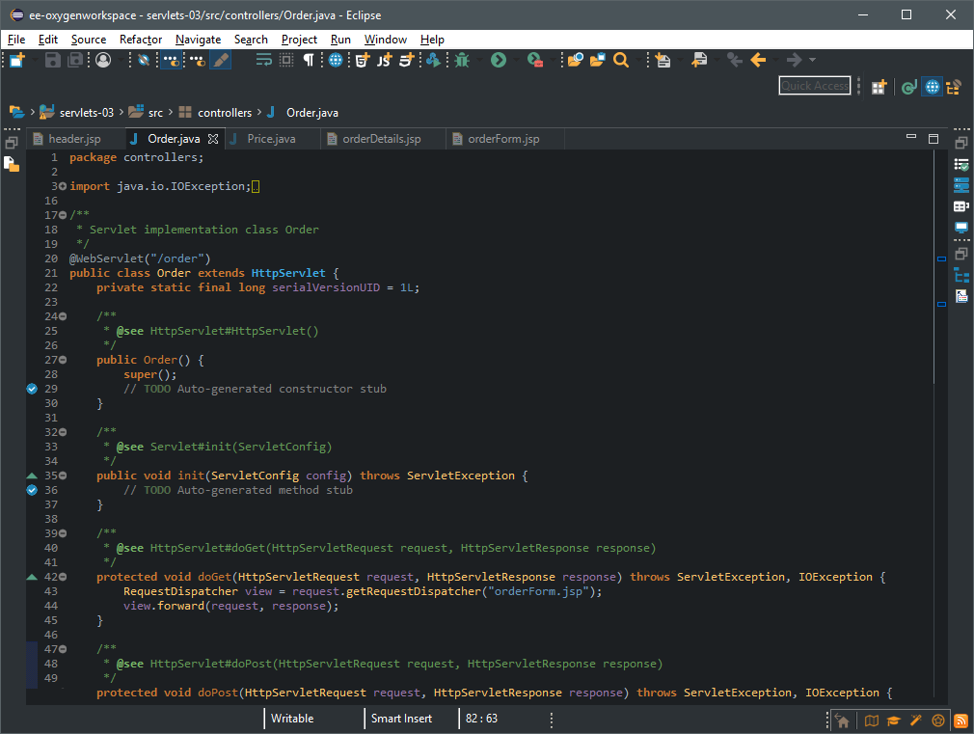
Note the URL mapping
Set the doGet() method to dispatch the orderForm.jsp file

Slide 10
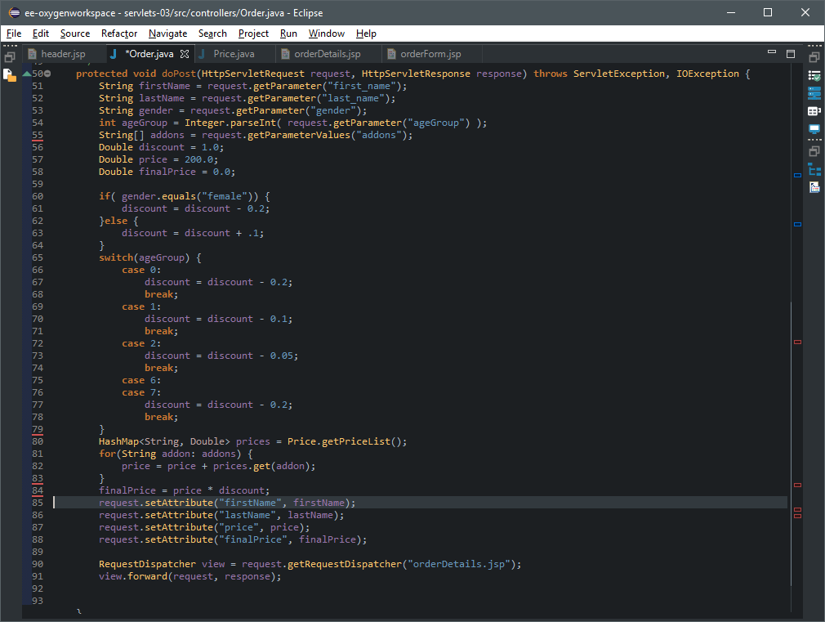
Capture the form data and set the initial values
Calculate discounts
Get the prices of the checked items
Apply discounts
Send to view

Slide 11
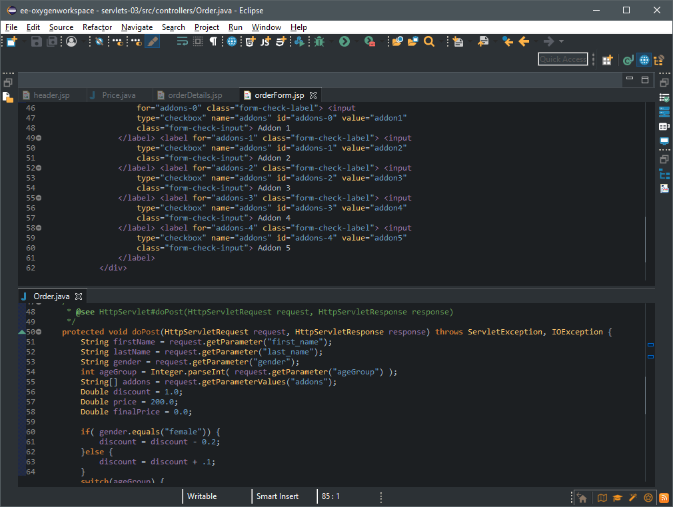
A note on input field arrays
Notice how all the checkboxes have the same name
These can be accessed by the servlet as a String array via the method getParameterValues() instead of getParameter(), and can be unpacked/ iterated over like any other array

Slide 12
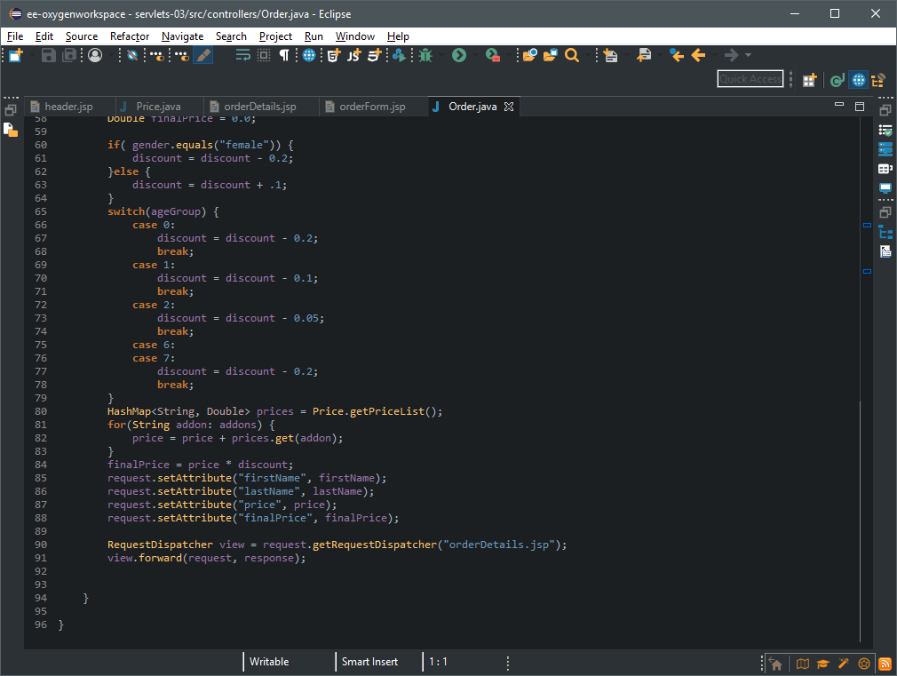
We iterate over the addons array and look the values up in the priceList HashMap from the Price static class
Only the checked addons are included in the addons array, and the values are added to the price

Slide 13
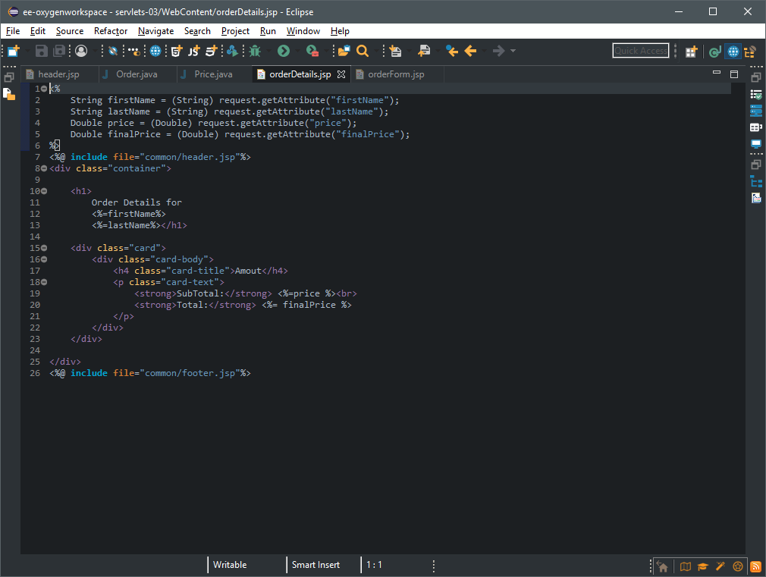
Load the values from the servlet
(note the <% %> signifying Java code to be run on the JSP)
Display the values
<%=attribute%>

Slide 14
Activity Suggestion
Objectives
Add VAT
Calculate compound interest (either through iteration or the formula [P (1 + i)^{n}] – P, where P is the principal, i is the interest rate, and n is the number of compounding periods
Outcomes
Learner demonstrates problem-solving skills and ability to expand on previous knowledge
KPI
Test case: Assuming all addons and a 20% discount plus 12% VAT, total price should be 3,427.2, 5,861.675 if deferred with 586.1675 monthly payments for 12 months
Expand output to include calculation for VAT (12%) and an option for 12 deferred payments on 6% compound interest monthly; final price should include total price and a monthly breakdown of payments

